Slide 1


ACT® Aspire®
Managing and Registering Students in PearsonAccess^{next}
Notes:
Welcome to the ACT Aspire Managing and Registering Students in PearsonAccess^{next} training. This training addresses the steps required for populating and managing student data in PearsonAccess^{next}.

Slide 2





Agenda
Student Registration Import
Create and Register Students Manually
Edit Student Records
Transfer Students
Notes:
During the training, we’ll review how to perform the following tasks in PearsonAccess^{next}
Student Registration Import
Create and Register Students Manually
Edit Student Records
Transfer Students

Slide 3
Student Registration Import
Notes:
There are two ways to add students to PearsonAccess^{next}. You can add students manually or by file import.
First, we will cover the Student Registration Import process. ADE uploads students for the state in January based on student enrollment data in AzEDS. After the ADE import, any newly enrolled students and any students missed in the ADE import will need to be added by the school or district.
Users with the Administration Test Coordinator and Test Coordinator roles are able to import student registration information.

Slide 4
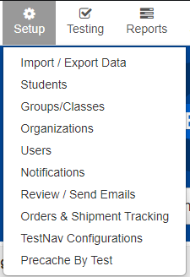
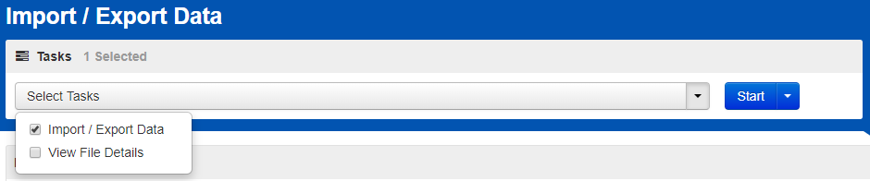



Student registration import
Setup > Import / Export Data
Notes:
Use the resources under the “Managing Students” menu of the Arizona ACT Aspire Support page to guide you through the process for importing student registration information.
If you’re testing on paper, you’ll need to ensure your Student Registration Import (or SRI) is complete prior to the deadline listed in the ACT Aspire Schedule of Events.
To import an SRI file, go to the “Setup” menu, and select “Import/Export Data.” Select the “Import/Export Data” task.

Slide 5
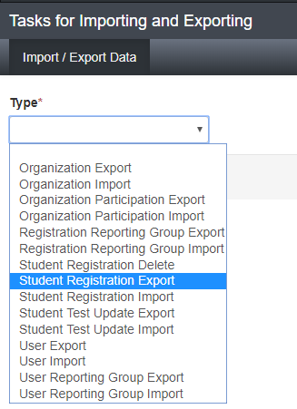
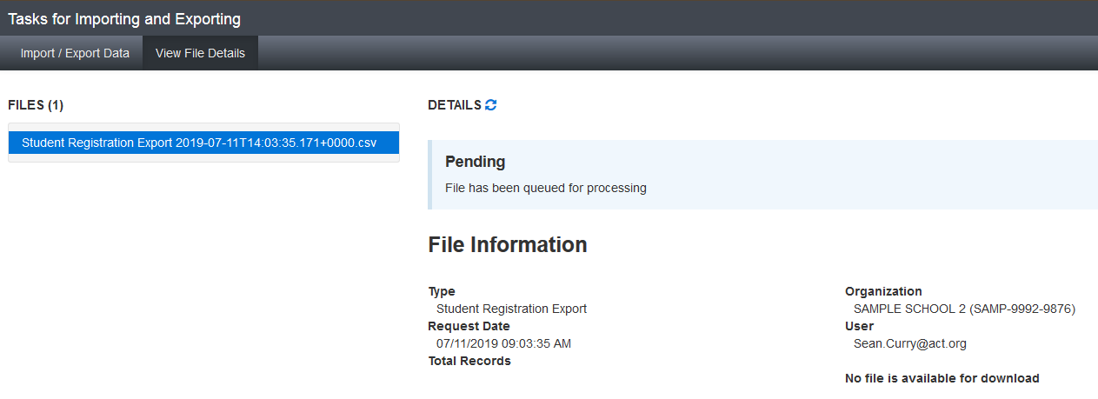


Student registration import
Student Registration Export
Notes:
The first step is to complete a Student Registration Export file. To access the file layout header, on the tasks screen, select the “Student Registration Export” type, then click “Process.”
The file will show in pending status until the download is complete. You can click on the refresh button next to “Details” to see the status change, but you’ll also get an email when the file is Complete. When the file is ready to download, the status will change to Complete, and you will be able to download the file.
All files exported out of PearsonAccess^{next} are CSV files, so it will be important that you download and open the files in a way that preserves leading zeros and number formatting.

Slide 6
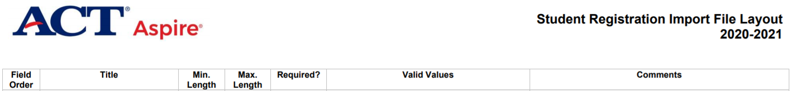
Student registration import
Student Registration Import File Layout
Notes:
Download the SRI File Layout instructions from the Arizona ACT Aspire Support Page in the “Managing Students” section.
Use the SRI File Layout instructions to add all required information to the file. The layout instructions let you know which fields are required and what characters are accepted in each column of the student registration file.
When you have completed the file, save it as a CSV file format. You will get a prompt that asks whether you want to keep that file format or change it. Say “Yes” you want to keep the file using that format.
Save the file with a recognizable file name and in a location where you’ll be able to find it easily to import to the system.

Slide 7
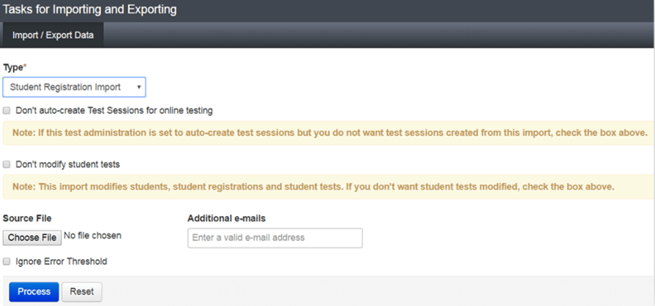
Student registration import
Setup > Import / Export Data > Start / All Tasks > Student Registration Import
Notes:
Once you have completed and saved the file, navigate back to PearsonAccess^{next}, and the “Import/Export” task screen. When importing the SRI file, review the text next to the checkboxes carefully and check them only if they apply to your file. In general, in your first import of students or when you're adding brand new students, you should NOT check any of the checkboxes.
Note that the checkboxes on the screen are different for different files. Every time you're importing or exporting a file, review the checkboxes carefully and make the appropriate selections.

Slide 8
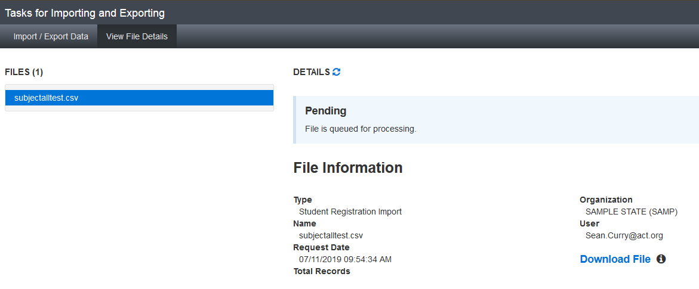

Student registration import
Student Registration Import
Notes:
If the file is done, it will change to “Complete”. If it isn’t done, wait a little longer and click refresh.
Again, your file will process, and you will see a notification when the file upload is “Complete”.
On the “Complete” page, you’ll also be notified if there are any errors in your file. The errors will show on the page, or you’ll be able to download the records in error, correct them, and upload them again.

Slide 9
Create and Register Students Manually
Notes:
Next, we will look at creating and registering students manually in PearsonAccess^{next}.

Slide 10
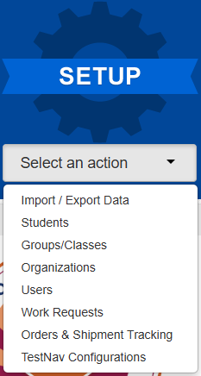
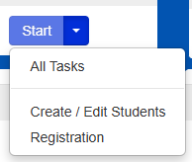
Create and register students Manually
Create Students
Notes:
To create a student record, select “Students” from the “Setup” menu on the PearsonAccess^{next} home screen.
Next, from the “Students” page, select “All Tasks” from the “Start” menu.

Slide 11
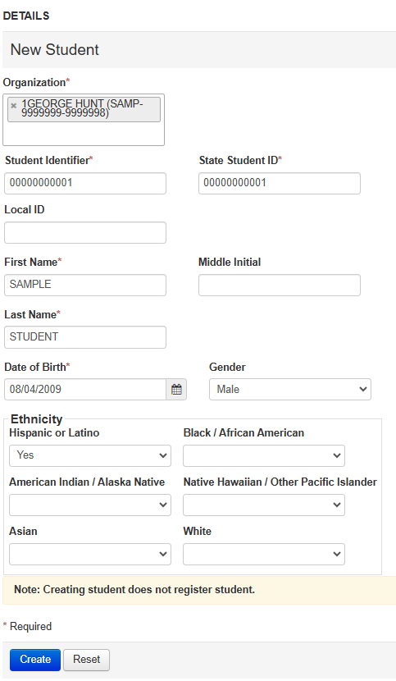
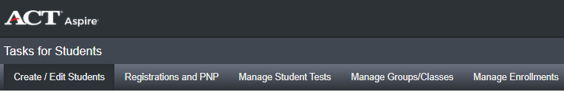
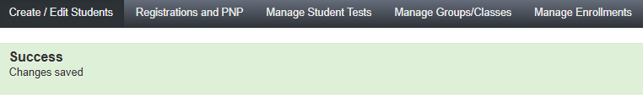
Create and register students Manually
Create Students
Notes:
The “Tasks for Students” page will open on the “Create/Edit Students” tab.
Fill in the New Student details. All required fields are indicated with an asterisk.
When all information is entered, click the “Create” button.
A green “Success” banner will appear to confirm the student was created successfully.

Slide 12
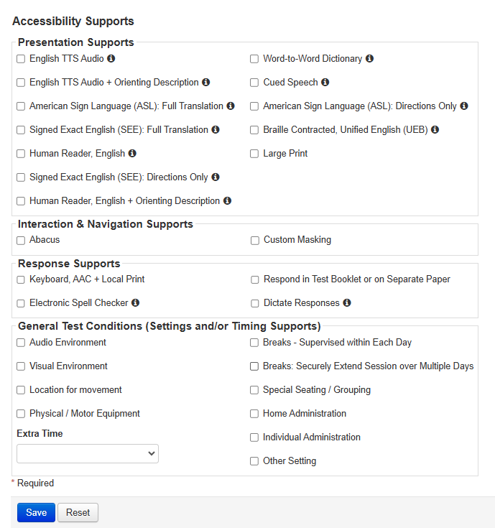
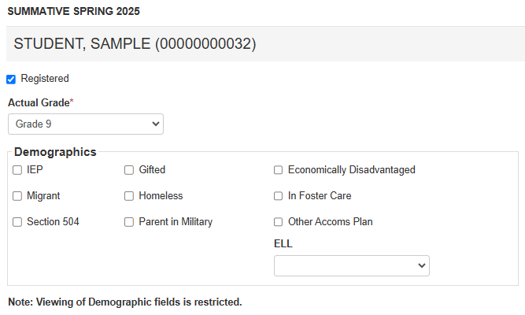
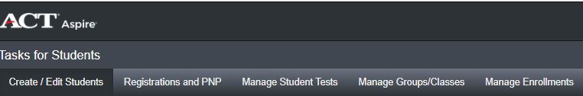
Create and register students Manually
Registrations and PNP
Notes:
Next, click on the “Registrations and PNP” tab at the top of the screen.
On the “Summative Spring 2025” Students page, place a check in the “Registered” checkbox, then select the student’s grade from the “Actual Grade” menu.
Review the “Demographics” options and place a check in the checkbox for any that apply.
Continue to scroll down the page to select the appropriate accessibility supports for the students if needed. These are not required fields. Click “Save” when complete. These “Accessibility Support” options are often referred to as a student’s PNP, or Personal Needs Profile.

Slide 13
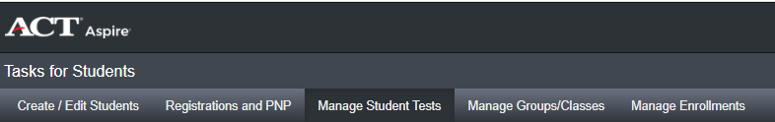
Create and register students Manually
Manage Student Tests
Notes:
Next, click on the “Manage Student Tests” tab.

Slide 14
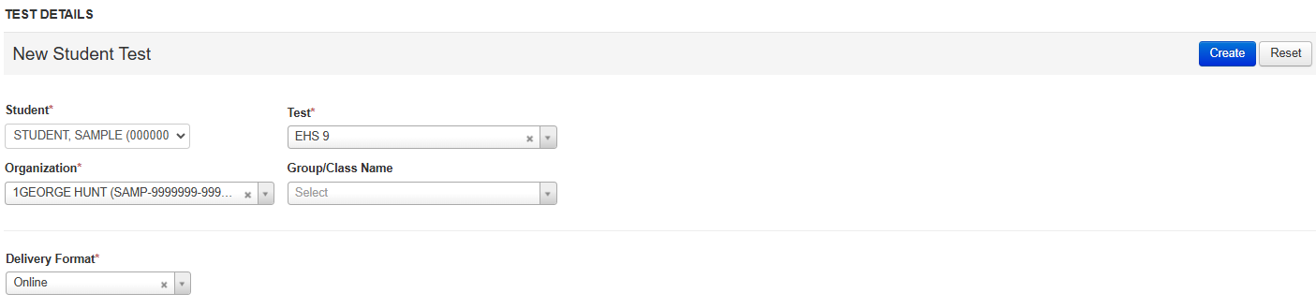
Create and register students Manually
Manage Student Tests
Notes:
On the “Test Details” page, select the student from the “Student” menu.

Slide 15
Create and register students Manually
Manage Student Tests
Notes:
Then, select EHS 9 from the Test dropdown menu. This will assign all subjects of the Aspire test to the student.

Slide 16
Create and register students Manually
Manage Student Tests
Notes:
Next, select the correct “Organization” and “Delivery Format” from the dropdown menus. Then click “Create”.

Slide 17
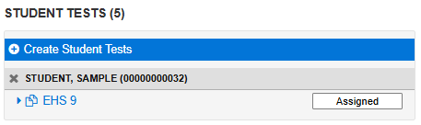
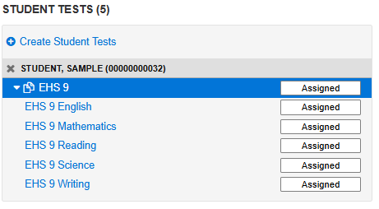
Create and register students Manually
Manage Student Tests
Notes:
On the “Student Tests” menu, click on the arrow to expand the list of the student’s test assignments.
The expanded list will show all of the ACT Aspire tests assigned to the student.

Slide 18
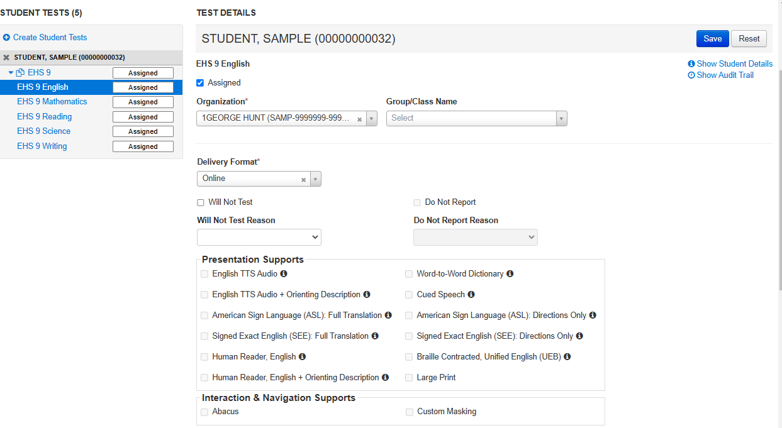
Create and register students Manually
Manage Student Tests
Notes:
Accessibility Supports selected on the “Registrations and PNP” tab will be applied to a test if applicable.
Click on each test in the “Student Tests” menu to review the Accessibility Supports for the student. The Accessibility Support options are Read Only on this page. Any edits to a student’s PNP must be applied in the “Registrations and PNP” tab.

Slide 19
Edit Student Records
Notes:
Now, we will look at editing student records in PearsonAccess^{next}. This process is used to update data in PearsonAccess^{next} for students that are already loaded.

Slide 20
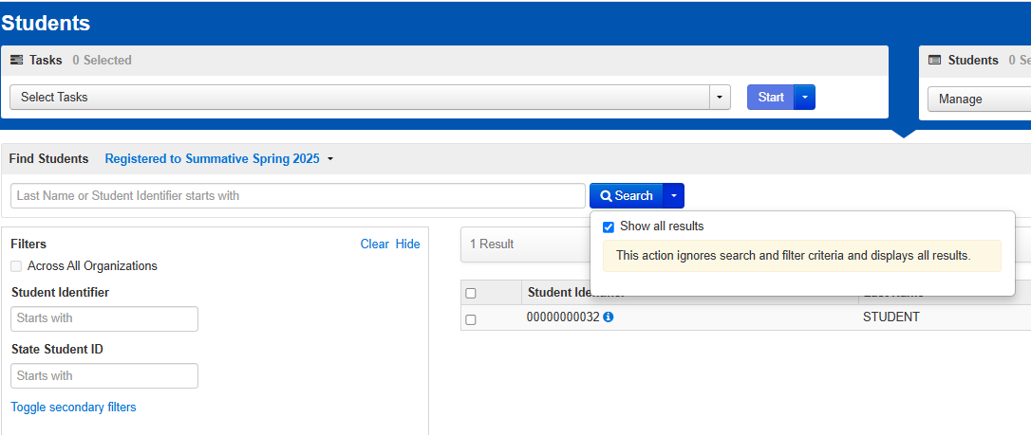
Edit Student Records
Editing Student Demographic Information
Notes:
To edit a student record, select “Students” from the “Setup” menu on the PearsonAccess^{next} home screen.
Next, on the “Students” page, you can use the filters to find a specific student or click on the “Search” dropdown arrow and check the “Show all results” check box.

Slide 21

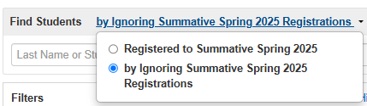
Edit Student Records
Editing Student Demographic Information
Notes:
If you do not find the student using the search filters or using “Show all results”, the student either has not been created in PearsonAccess^{next}, or their registration is incomplete. The default view on the “Students” page is to show students that have complete registrations.
To view students with incomplete registrations, use the “Find Students” dropdown to select the “by Ignoring Summative Spring 2025 Registrations” radio button.

Slide 22
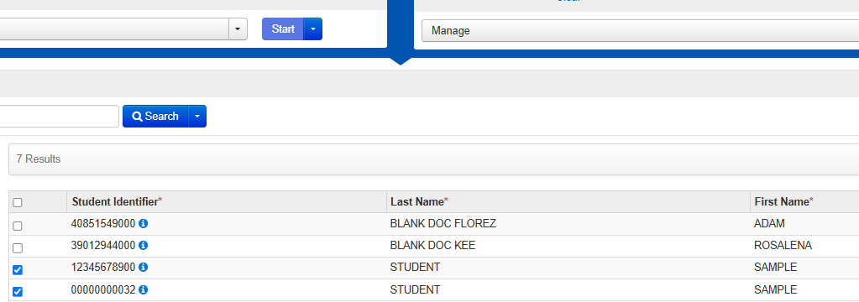
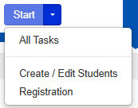
Edit Student Records
Editing Student Demographic Information
Notes:
Place a checkmark in the check box for each student that requires an update and then click “Start>All Tasks”.

Slide 23
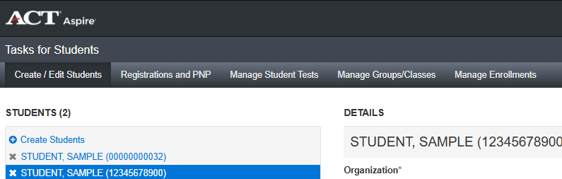
Edit Student Records
Tasks for Students Page
Notes:
On the “Tasks for Students” page, select the tab for the information that requires updating.
Use the “Create / Edit Students” tab to update student name, date of birth, SSID, gender and ethnicity
Use the “Registrations and PNP” tab to update demographics such as student services and Accessibility Supports
Use the “Manage Student Tests” tab to update delivery format of the test (online test, paper)
Use the “Manage Groups/Classes” tab to create a new testing group, or assign students to a testing group

Slide 24
Transfer students
Notes:
Next, we will cover transferring students in or out of your school in PearsonAccess^{next}.

Slide 25
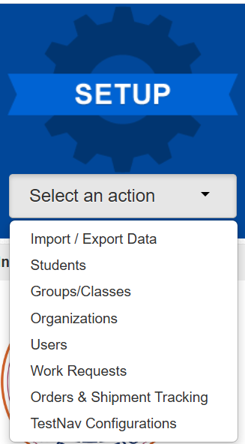
Transfer students
Initiating a Student Transfer
Notes:
Student Transfers are Work Requests in PearsonAccess^{next}.
To initiate a Student Transfer into a school in your district, select “Work Requests” from the “Setup” menu.

Slide 26
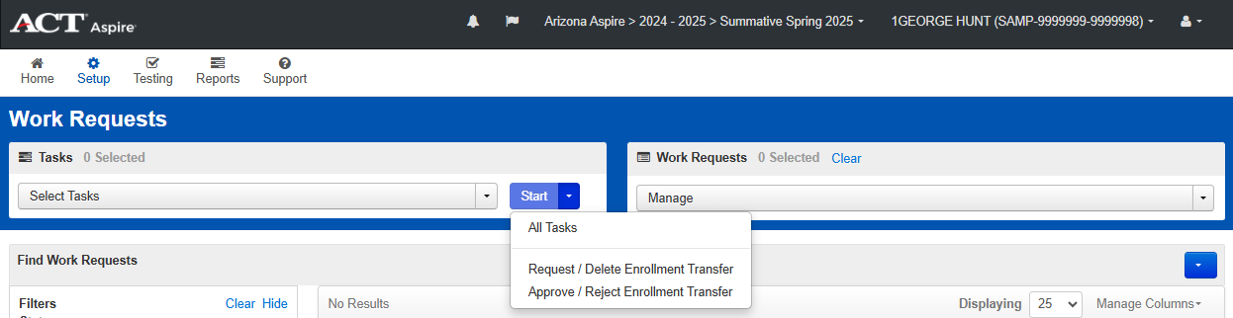
Transfer students
Initiating a Student Transfer
Notes:
On the “Work Requests” page, click Start>All Tasks.

Slide 27
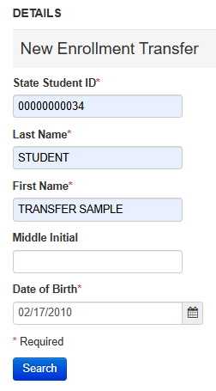
Transfer students
Initiating a Student Transfer
Notes:
On the “New Enrollment Transfer” page, enter the transfer student’s State Student ID (SSID), Last Name, First Name, and Date of Birth, then click the “Search” button.

Slide 28
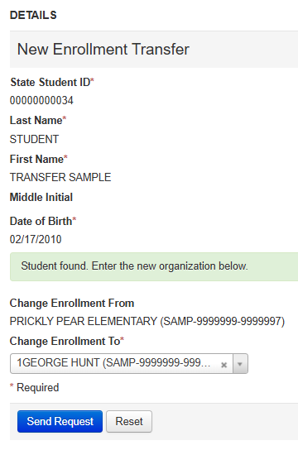
Transfer students
Initiating a Student Transfer
Notes:
Once the student record populates, select the student’s new school from the “Change Enrollment To” dropdown menu.

Slide 29
Transfer students
Initiating a Student Transfer
Notes:
Next, click the “Send Request” button.

Slide 30
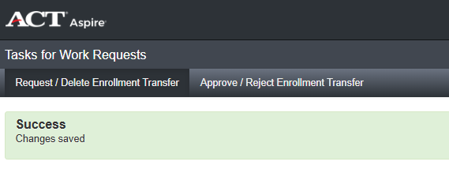
Transfer students
Initiating a Student Transfer
Notes:
A green “Success” banner will appear to confirm your Transfer Work Request is complete. The student will be transferred into the new school upon approval of the transfer request from the student’s previous school.

Slide 31
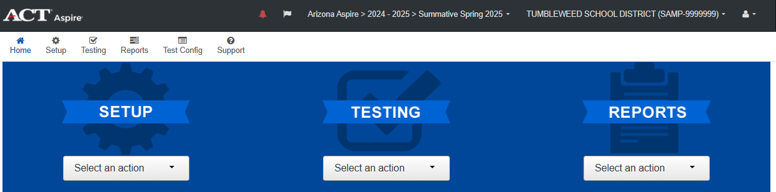
Transfer students
Approving a Student Transfer Request
Notes:
District Test Coordinators are notified of pending transfer requests in two ways. They will receive an email from noreply@mail.pearsonaccessnext.com and the next time they log in to PearsonAccess^{next} they will see that the bell icon is red.

Slide 32
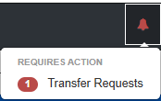
Transfer students
Approving a Student Transfer Request
Notes:
If you have received notice of a Work Request that is pending approval, click on the red “bell” icon in PearsonAccess^{next} and click “Transfer Requests”.

Slide 33
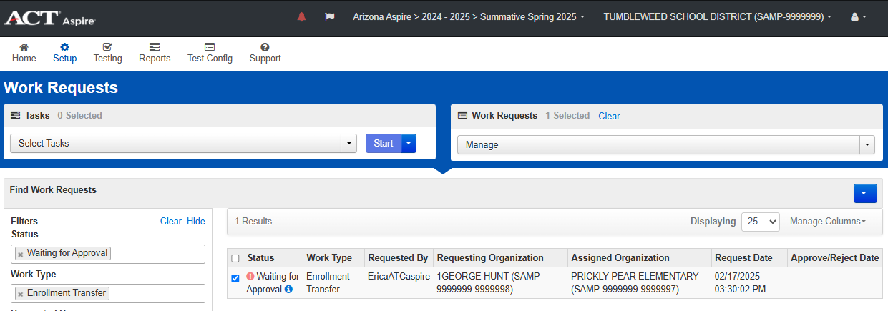
Transfer students
Approving a Student Transfer Request
Notes:
On the Work Requests page, place a check in the box for the Student Transfer Request.

Slide 34
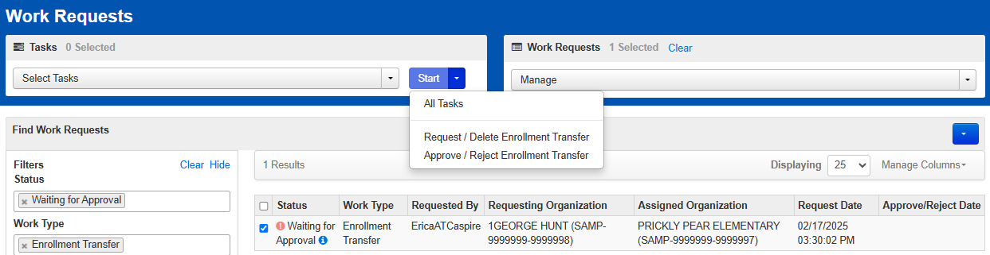
Transfer students
Approving a Student Transfer Request
Notes:
Next, click Start > Approve / Reject Enrollment Transfer

Slide 35
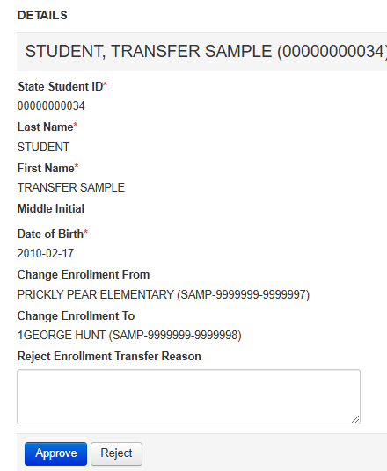
Transfer students
Approving a Student Transfer Request
Notes:
On the “Approve / Reject Enrollment Transfer” Details page, review the student’s information.
If the student has not completed testing at your school, approve the request.
If the student has completed testing at your school, type “Student completed testing” in the Reject Enrollment Transfer Reason box and reject the request.

Slide 36
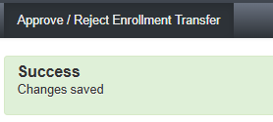
Transfer students
Approving a Student Transfer Request
Notes:
A green “Success” banner will appear to confirm your approval or rejection has been submitted.

Slide 37

Questions? We’re here to help!
Pearson Customer Support
Phone: 1.888.705.9421 Option 4 (ACT Aspire), 7:00 a.m. – 7:00 p.m., central time, Monday through Friday
Notes:
This concludes the ACT Aspire Managing and Registering Students in PearsonAccess^{next} training. If you have any questions, please contact us at the number provided on this slide.

